Slide 1
TECH PIRATES E-COMMERSE WEBSITE
Login
Password
Customer
Seller
New User..?
Login

Slide 2
TECH PIRATES E-COMMERSE WEBSITE
Login
Password
Customer
Seller
New User..?
Login
PIRATES_SP_CUSTOMERLOGINCHECK

Slide 3
LOGIN FAILED.. INVALID PASSWORD
Go Back

Slide 4
INVALID USER… USER ID DOES NOT EXISTS…
Go Back

Slide 5
Registration For New User
Email
Re-enter Email
Password
First Name
Last Name
Mobile Number (optional)
Register
PIRATES_SP_CREATE_USER_CUSTOMER
Go Back

Slide 6
All Categories
Deals
Appliances
Buy List
Movies, Music & Games
PIRATES_SP_BUY_LIST
Cancel List
Electronics
PIRATES_SP_CANCEL_LIST
Fashion
Order History
Add Item to List
PIRATES_SP_ADD_ITEMS_TO_LIST
PIRATES_SP_ORDER_HISTORY
Modify Item on List
PIRATES_SP_MODIFY_ITEMS_ON_LIST
Shipping Details
View Item on List
PIRATES_SP_VIEW_ITEM_ON_LIST
Card Details
Delete Item from List
PIRATES_SP_DELETE_ITEM_ON_LIST
Log Out

Slide 7
Deals
Weekly Deals
PIRATES_SP_WEEKLY_DEALS
Monthly Deals
PIRATES_SP_MONTHLY_DEALS
Hottest Deals
PIRATES_SP_HOTTEST_DEALS
Go Back

Slide 8
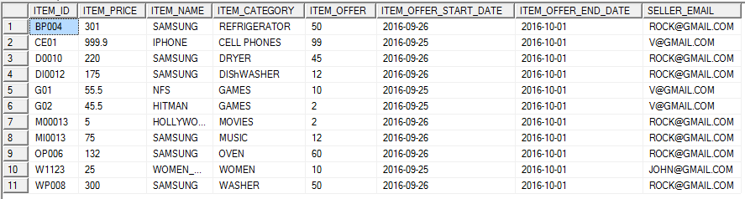
Weekly Deals
Go Back

Slide 9
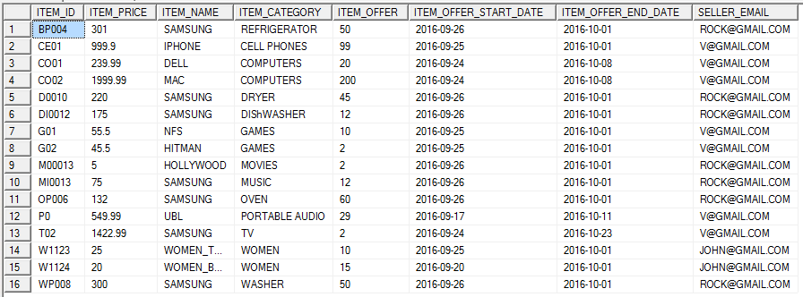
Monthly Deals
Go Back

Slide 10
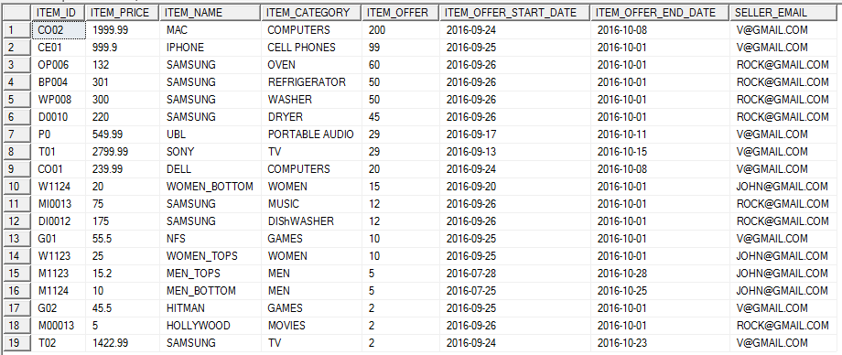
Hottest Deals
Go Back

Slide 11
Appliances
Refrigerator
PIRATES_SP_REFRIGERATOR
Oven
PIRATES_SP_OVEN
Washer and Dryer
PIRATES_SP_WASHER_AND_DRYER
Dishwasher
PIRATES_SP_DISHWASHER
Go Back

Slide 12
Refrigerator
Go Back

Slide 13
Oven
Go Back

Slide 14
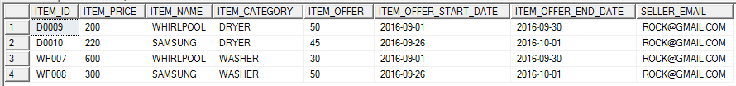
Washer and Dryer
Go Back

Slide 15
Dishwasher
Go Back

Slide 16
Movies, Music & Games
Latest Collections
PIRATES_SP_MUSIC_MOVIES_AND_GAMES_LATEST
Old Collections
PIRATES_SP_MUSIC_MOVIES_AND_GAMES_OLD
Last View Collections
PIRATES_SP_MUSIC_MOVIES_AND_GAMES_LAST_VIEW
Go Back

Slide 17
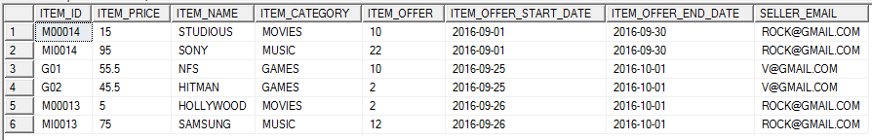
Latest Collection
Go Back

Slide 18
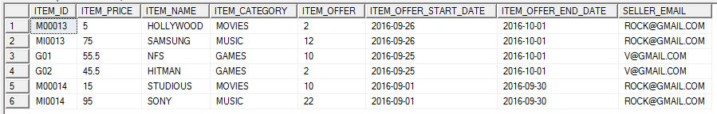
Old Collection
Go Back

Slide 19
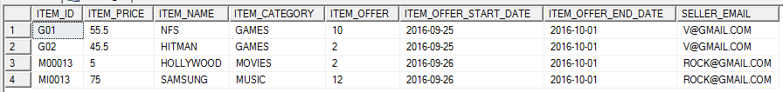
Last View Collection
Go Back

Slide 20
Electronics
Cell Phones
PIRATES_SP_CELLPHONES
Camera
PIRATES_SP_CAMERA
Computers
PIRATES_SP_COMPUTERS
Portable Audio
PIRATES_SP_PORTABLE_AUDIO
TV
PIRATES_SP_TV
Go Back

Slide 21
Cell Phones
Go Back

Slide 22
Camera
Go Back

Slide 23
Computer
Go Back

Slide 24
Portable Audio
Go Back

Slide 25
TV
Go Back

Slide 26
Fashion
Women
PIRATES_SP_WOMEN
Men
PIRATES_SP_MEN
Kids
PIRATES_SP_KIDS
Jewellery
PIRATES_SP_JEWELLERY
Beauty and Health
PIRATES_SP_BEAUTY_AND_HEALTH
Go Back

Slide 27
Women
Go Back

Slide 28
Men
Go Back

Slide 29
Kids
Go Back

Slide 30
Jewelry
Go Back

Slide 31
Beauty and Health
Go Back

Slide 32
Add Item to List
E-MAIL
ITEM_ID
QUANTITY
SHIPPING_ADDRESS
SHIPPING_TYPE
Add item
Go Back

Slide 33
Modify Item on List
E-MAIL
ITEM_ID
QUANTITY
SHIPPING_ADDRESS
SHIPPING_TYPE
Modify item
Go Back

Slide 34

View Item on List
Modify item
Go Back

Slide 35
Delete Item from List
DIA@GMAIL.COM
ITEM_ID
Delete item
Go Back

Slide 36

Buy Item
E-MAIL
DIA@GMAIL.COM
Proceed
Cancel List
Go Back

Slide 37
Buy Item
E-MAIL
DIA@GMAIL.COM
LIST EMPTY
Go Back

Slide 38

Order History
E-MAIL
DIA@GMAIL.COM
Go Back

Slide 39
Shipping Details
E-MAIL
DIA@GMAIL.COM
Add Shipping Details
PIRATES_SP_ADD_SHIPPING
Select Shipping Details
PIRATES_SP_SELECT_SHIPPING
Delete Shipping Details
PIRATES_SP_DELETE_SHIPPING
Cancel
Go Back

Slide 40
Add Shipping Details
E-MAIL
DIA@GMAIL.COM
SHIPPING_ADDRESS
SHIPPING_TYPE
SHIPPING_CHARGE
Add Details
Go Back

Slide 41

Select Shipping Details
Proceed
Go Back

Slide 42
Delete Shipping Details
DIA@GMAIL.COM
SHIPPING_ADDRESS
SHIPPING_TYPE
Delete Details
Go Back

Slide 43
Card Details
E-MAIL
DIA@GMAIL.COM
Add Card Details
PIRATES_SP_ADD_CARD_DETAILS
Select Card Details
PIRATES_SP_SELECT_CARD_DETAILS
Delete Card Details
PIRATES_SP_DELETE_CARD_DETAILS
Cancel
Go Back

Slide 44
Add Card Details
CARD_NUMBER
EMAIL
CARD_OWNER
CARD_TYPE
CVV
EXPIR DATE
Add Details
Go Back

Slide 45

Select Card Details
PLACE ORDER
Go Back

Slide 46
Delete Card Details
DIA@GMAIL.COM
CARD_NUMBER
Delete Details
Go Back

Slide 47
TECH PIRATES E-COMMERSE WEBSITE
Login
Password
Customer
Seller
New User..?
Login
PIRATES_SP_SELLERLOGINCHECK

Slide 48
LOGIN FAILED.. INVALID PASSWORD

Slide 49
INVALID USER… USER ID DOES NOT EXISTS…

Slide 50
Registration For New Seller
Email
Re-enter Email
Password
Company Name
User Name
Mobile Number(optional)
Register
PIRATES_SP_CREATE_USER_SELLER
Go Back

Slide 51
Seller Menu
View Listed Item
PIRATES_SP_VIEW_LISTED_ITEMS_SELLER
Add Item to List
PIRATES_SP_ADD_ITEMS_TO_LIST_SELLER
Modify Item on List
PIRATES_SP_MODIFY_ITEMS_ON_LIST_SELLER
Delete Item from List
PIRATES_SP_DELETE_ITEMS_ON_LIST_SELLER
Log Out

Slide 52
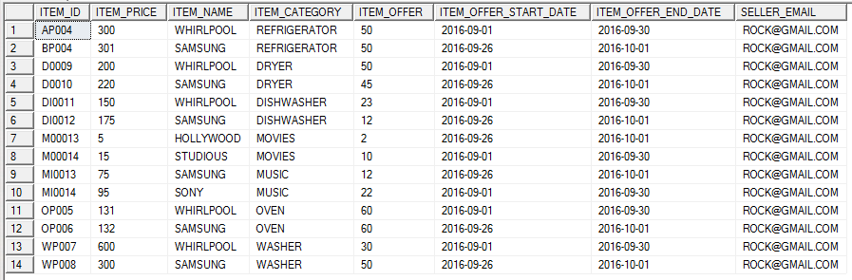
View Listed Item
E-MAIL
ROCK@GMAIL.COM
Go Back

Slide 53
Add Item to List
E-MAIL
ROCK@GMAIL.COM
ITEM_ID
ITEM_PRICE
ITEM_NAME
ITEM_CATEGORY
ITEM_OFFER
ITEM_OFFER_START_DATE
ITEM_OFFER_END_DATE
Add Item
Go Back

Slide 54
Modify Item on List
E-MAIL
ROCK@GMAIL.COM
ITEM_ID
ITEM_PRICE
ITEM_NAME
ITEM_CATEGORY
ITEM_OFFER
ITEM_OFFER_START_DATE
ITEM_OFFER_END_DATE
Modify Item
Go Back

Slide 55
Delete Item from List
ITEM_ID
Delete Item
Go Back

